Slide 1
First- and Last-Touch Attribution with CoolTShirts.com
By Sasan Valinejad
Feb 15, 2019

Slide 2
Table of Contents
Get familiar with CoolTShirts
What is the user journey?
Optimize the campaign budget

Slide 3
1.1 How many campaigns and sources does CoolTShirts use and how are they related?
There are a total of 8 campaigns and 6 sources that assist CoolTShirts with their marketing. Each source is related to a campaign that is helping this market. For example, buzzfeed is a campaign responsible for ten-crazy-cool-tshirts-facts source and nytimes is responsible for source getting-to-know-cool-tshirts.
Also, we can see that weekly-newsletter and retargeting-campaign sources are backed by email campaign.
utm_source | utm_campaign
nytimes | getting-to-know-cool-tshirts
email | weekly-newsletter
buzzfeed | ten-crazy-cool-tshirts-facts
email | retargetting-campaign
facebook | retargetting-ad
medium | interview-with-cool-tshirts-founder
google | paid-search
google | cool-tshirts-search
SELECT COUNT(DISTINCT utm_campaign)
FROM page_visits;
SELECT COUNT(DISTINCT utm_source)
FROM page_visits;
SELECT DISTINCT utm_campaign, utm_source
FROM page_visits;

Slide 4
1.2 What pages are on their website?
There are 4 distinct pages on their website. These four pages (landing_page, shopping_cart, checkout, purchase) are key elements for discovering the user journey through CoolTShirts.
SELECT COUNT(DISTINCT page_name)
FROM page_visits;
page_visits
page_name | TEXT
timestamp | TEXT
user_id | INTEGER
utm_campaign | TEXT
utm_source | TEXT
page_name
1 - landing_page
2 - shopping_cart
3 - checkout
4 - purchase

Slide 5
2. What is the user journey?
Let’s explore the user Journey by looking at some data.
For this example, we want to see users journey to determine what campaign and sources are responsible for each user or how many first touches occurred on a certain campaigns or who made a purchase where or even which campaign is responsible for most purchases?

Slide 6
2.1 User Journey – Understanding the Data
First, we want to make sure of the data that is necessary to complete this query (the columns within the tables).
User_id – this attribute is responsible for a distinct user and actions recorded
Timestamp – is a unique attribute to each user_id. Telling a story as when the user visited a page, added an item to their cart, or even made a purchase.
utm_source – the source is the responsible attribute for market coolTShirt that has led a user to consider CoolTShirt.
utm_campaign – is a responsible party for the utm_source

Slide 7
2.1 User Journey – Manipulating the Data
STEP 1- Temp Table
We now have the attributed necessary but notice they are on different tables? Well, as we learned from Intro to SQL, we can perform a few statements to bring all of this data together in an organized and simplified manner to evaluate the user journey experience.
I’ve broken out our coding journey ahead into 4 steps (creating a temp table, aggregate functions, Select statement from multiple tables and joining multiple tables)
Step 1. Create a temporary table to represent the data we are looking for:
Thanks to Code Academy, I’ve learned that by giving an alias to your tables and columns can help simplify visuals when working with large number of data and having to write lengthy codes and joining tables.
We start with giving our temp table an alias – ‘First_touch’
Next, we want to Select the relevant columns relatable to user journey as discussed earlier,
User_Id, timestamp

Slide 8
2.1 User Journey – Manipulating Data
STEP 2 – Aggregate Functions
Step 2. Aggregate functions:
Since there are many timestamps in the table, let’s narrow it down to first touches by aggregating it.
MIN will perform as the first touch of a user’s timestamp; therefore
MIN(timestamp) – next we will give it an alias ‘first_touch_at’
Next, we will group the tables by user_id
So far, we have a temp table as below
WITH first_touch AS (
SELECT user_id,
MIN(timestamp) as first_touch_at
FROM page_visits
GROUP BY user_id)

Slide 9
2.1 User Journey – Manipulating Data
STEP 3 – SELECT & Multiple Tables
STEP 3. Select statement from multiple tables:
Now we want to select our results from the temp table and join few other fields to better understand the user journey.
ft.user_id,
ft.first_touch_at,
pv.utm_source,
pv.utm_campaign,
As I mentioned earlier, we are using the alias in our select statement to perform this query.
Ft as for first touch table and pv for pagevisits table.

Slide 10
2.1 User Journey – Manipulating Data
STEP 4 - Joins
Step 4. Joining the tables:
Since we are using multiple tables, we want to make sure that we are joining the tables on user_id to extract relatable data
FROM first_touch ft
JOIN page_visits pv
ON ft.user_id = pv.user_id
Next, we also want to make sure we are adequately joining our first touch_at attribute to the original timestamp column from pagevisits table
AND ft.first_touch_at = pv.timestamp

Slide 11
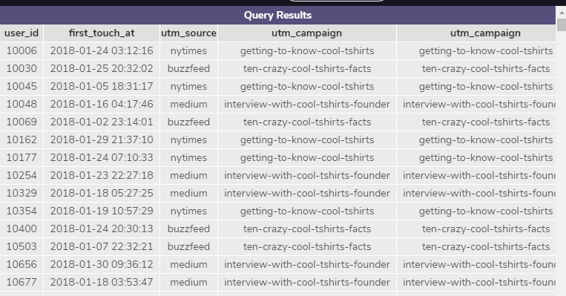
2.1 User Journey – Querying our Code
First touch – Run it…
Now we can use our code to navigate the tables from CoolTShirts tables and experience the user Journey:
WITH first_touch AS (
SELECT user_id,
MIN(timestamp) as first_touch_at
FROM page_visits
GROUP BY user_id)
SELECT ft.user_id,
ft.first_touch_at,
pv.utm_source,
pv.utm_campaign,
pv.utm_campaign
FROM first_touch ft
JOIN page_visits pv
ON ft.user_id = pv.user_id
AND ft.first_touch_at = pv.timestamp
;

Slide 12
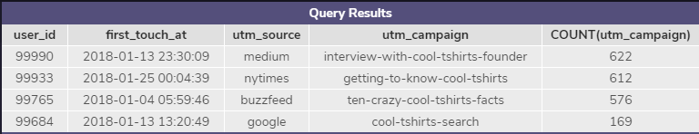
Now that we have written our code, we can simply edit/add few to it and see exactly how many first touch each campaign is responsible for (Highlighted in red).
To get a count, we can simple add a count function to campaign – see edits below:
Make sure to group by and
order by DESC (Optional)
WITH first_touch AS (
SELECT user_id,
MIN(timestamp) as first_touch_at
FROM page_visits
GROUP BY user_id)
SELECT ft.user_id,
ft.first_touch_at,
pv.utm_source,
pv.utm_campaign,
COUNT(utm_campaign) FROM first_touch ft
JOIN page_visits pv
ON ft.user_id = pv.user_id
AND ft.first_touch_at = pv.timestamp
GROUP BY utm_campaign
ORDER BY 5 DESC;
BONUS: ORDER BY – When using the order by function, you can either call out the column or use it’s position to call it out by its position number. In this case, we are ordering by the 5th column.
2.1 User Journey – Querying our Code
First touch - How many first touch each campaign is responsible for?

Slide 13
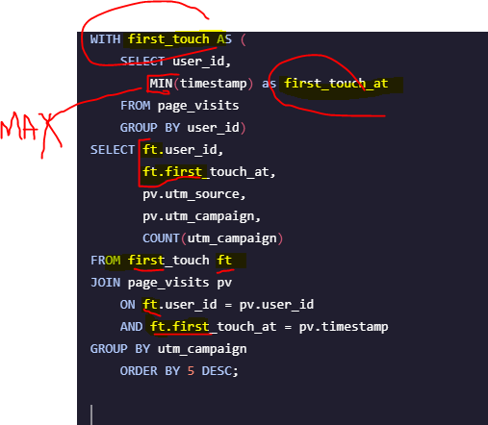
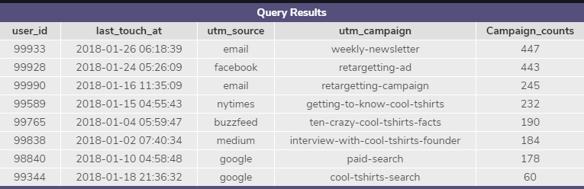
There are few options to answer the questions above – we can either write a new code, similar to the first touch methodology or edit the previous code and get last touch results. I am going to show you how to edit the existing code:
We need to make sure all first touch alias are now changed to ‘Last touch/ lt’
Also, we want to make sure we are changing the aggregate function for timestamp to represent last touch, which in this case would be MAX function.
WITH last_touch AS (
SELECT user_id,
MAX(timestamp) as last_touch_at
FROM page_visits
GROUP BY user_id)
SELECT lt.user_id,
lt.last_touch_at,
pv.utm_source,
pv.utm_campaign,
COUNT(utm_campaign) ‘Campaign_counts’
FROM last_touch lt
JOIN page_visits pv
ON lt.user_id = pv.user_id
AND lt.last_touch_at = pv.timestamp
GROUP BY utm_campaign
ORDER BY 5 DESC;
2.2 User Journey – new code or edit existing code?
Last Touch - How many last touch each campaign is responsible for?
Bonus: I have given an alias to utm_campaign

Slide 14
2.3 User Journey – Editing existing code:
Purchases How many visitors make a purchase?
This can be done by using a GROUP BY clause on page_name or a WHERE clause for page_name = ‘4 – purchase’
We need a distinct count of user_id
Followed with a Where Clause
SELECT COUNT(DISTINCT user_id)
FROM page_visits
WHERE page_name = '4 - purchase' ;
There are a total of 361 users that has made a purchase.

Slide 15
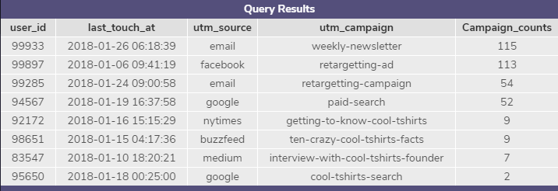
Here, we can use the existing code of Last_touch_at to find out how many of these users have made purchases. Similar to the last example in purchases, this can be done by using adding a GROUP BY clause on page_name or a WHERE clause for page_name = ‘4 – purchase’.
WITH last_touch AS (
SELECT user_id,
MAX(timestamp) as last_touch_at
FROM page_visits
WHERE page_name = '4 - purchase'
GROUP BY user_id)
SELECT lt.user_id,
lt.last_touch_at,
pv.utm_source,
pv.utm_campaign,
COUNT(utm_campaign) ‘Campaign_counts’
FROM last_touch lt
JOIN page_visits pv
ON lt.user_id = pv.user_id
AND lt.last_touch_at = pv.timestamp
GROUP BY utm_campaign
ORDER BY 5 DESC;
2.4 User Journey – Editing existing code:
Last Touch Purchases How many last touches on the purchase page is each campaign responsible for?

Slide 16
User Journey – Exploration
- What is the typical user journey?
We are able to determine the number of last touches on the purchase page that each campaign is responsible for. For example the weekly campaign, with email as the source, generated the highest number of purchases touches.
It is also possible to determine how many visitors eventually make a purchase. In this instance, 361 visitors made a purchase.
We are able to determine the number of last touches on the purchase page that each campaign is responsible for. For example the weekly campaign, with email as the source, generated the highest number of purchases touches.

Slide 17
Optimize the campaign budget
Here is my top 5 pick of campaigns that I recommend CoolTShirts to reinvest in and here is why.
I reviewed the tables and traced the campaigns from first touch, last touch and purchases to evaluate which campaign are responsible for the first touches, last touches and purchases made. I’ve added a new column AS ‘Dominance’ for each table to compare the counts with total.
My findings suggest that weekly-newsletter is most responsible for majority of the sales and retargeting-ad and retargeting-campaign are the following contestants. The last two campaigns have also show presents in interacting with users from early to mid and final stages of the user-journey.

